Slide 1
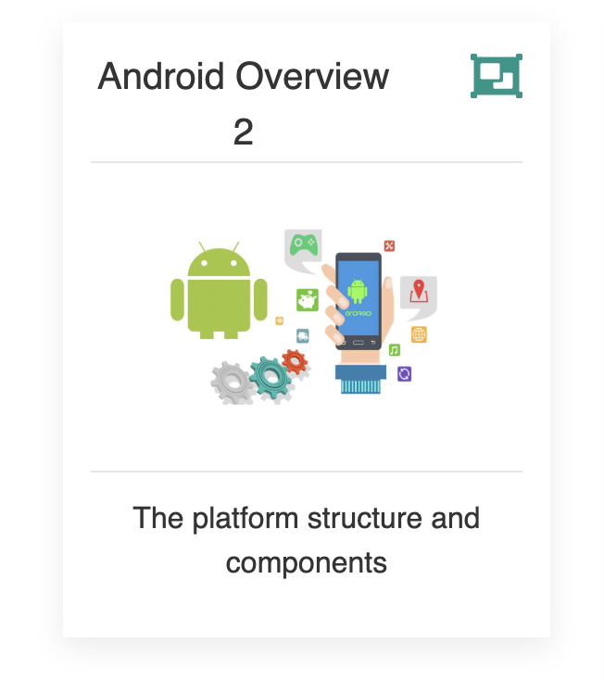

Slide 2
Agenda
The Platform
Setting up the Environment
Android Apps vs iPhone Apps

Slide 3
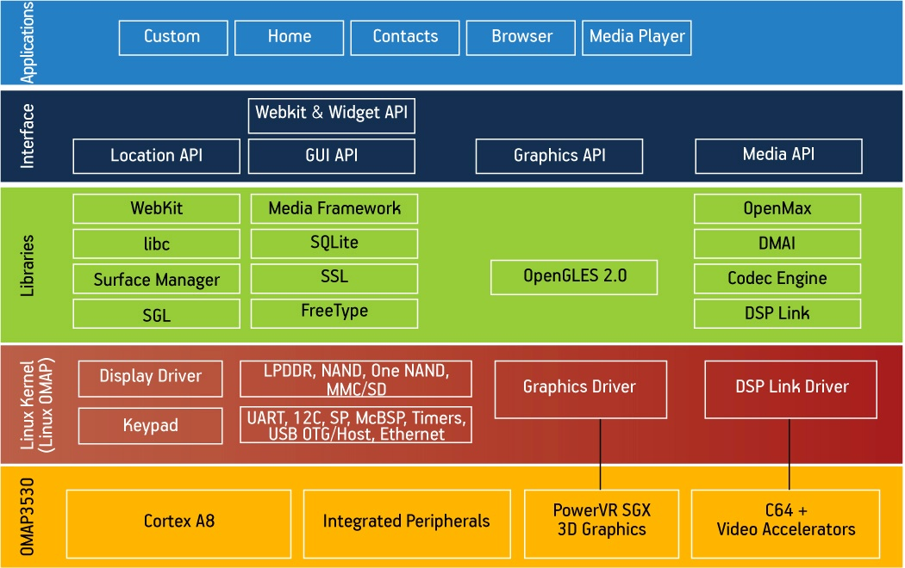
Comprehensive
Android is is a complete software stack for a mobile device..
Users can customize their phone experience substantially.
Manufacturers can also customise the platform can substantial ways - even generating complete ‘forks’ of the original project (Amazon).

Slide 4
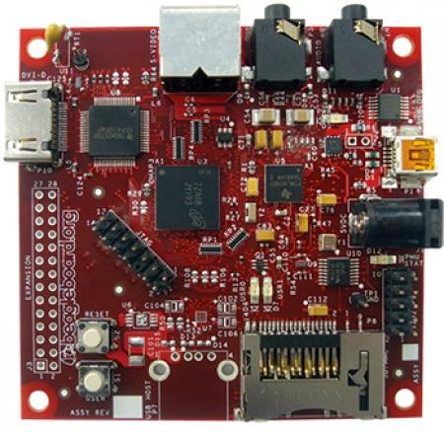
The Platform- Open Source
Android is an open source platform.
Aside from the Linux kernel itself, Android is licensed under business-friendly licenses (Apache/MIT/BSD) so that others can freely extend it and use it for variety of purposes.
Manufacturers can port Android OS to specific hardware. with minimal legal issues.
Android has many hooks at various levels of the platform, allowing anyone to extend it in unforeseen ways.
BeagleBoard, a low-power open-source hardware single-board computer produced by Texas Instruments

Slide 5
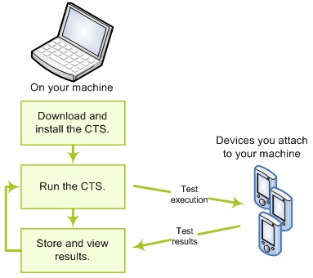
CTS
The Compatibility Test Suite (CTS), defines what it means to be an Android-compatible device.
CTS is a combination of automated tests as well as a document that specifies what an Android device must have, should have, or what features are simply optional.
The goal of CTS is to ensure that, for a regular consumer, an average app from the market will run on an average Android device if that device claims to be supporting a certain version of Android.

Slide 6
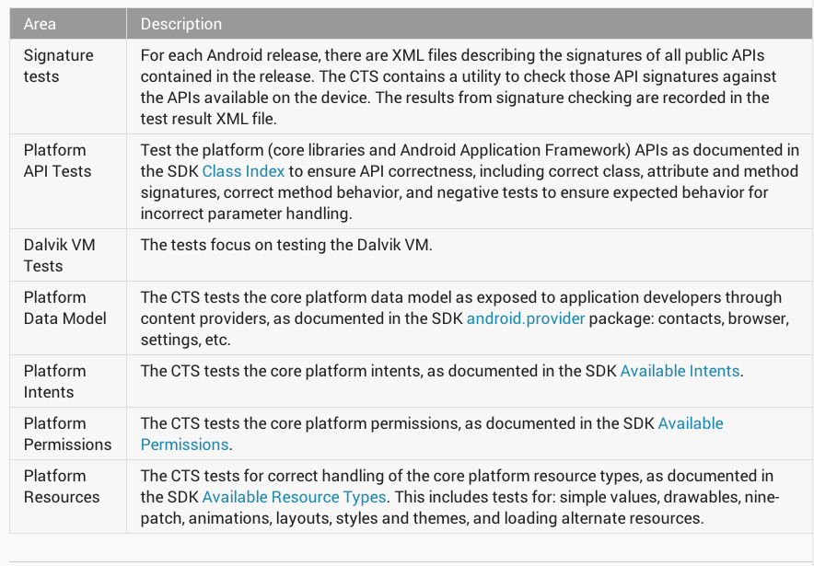
Compatibility is optional
CTS is being completely avoided by Amazon with the Kindle Fire and phone series of devices, built on top of the Android OS.
Anyone is welcome to download and “remix” Android in any way they see fit.
Android has been customized for everything from cars to satellites, and from photocopiers to washing machines.

Slide 7
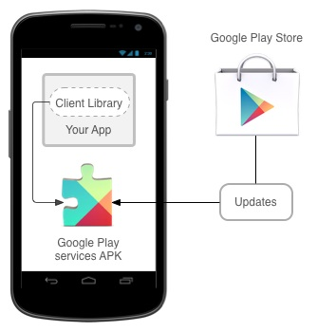
Google Play Services
The major reason manufacturers would want to ensure Android compatibility is access to Google Play Services, and its set of apps.
It allow apps to take advantage of the latest, Google-powered features such as Maps, Places, Google+, and more, with automatic platform updates distributed as an APK through the Google Play store.
Makes it faster for phone to receive updates and easier for developers to integrate the some new features into their apps.

Slide 8
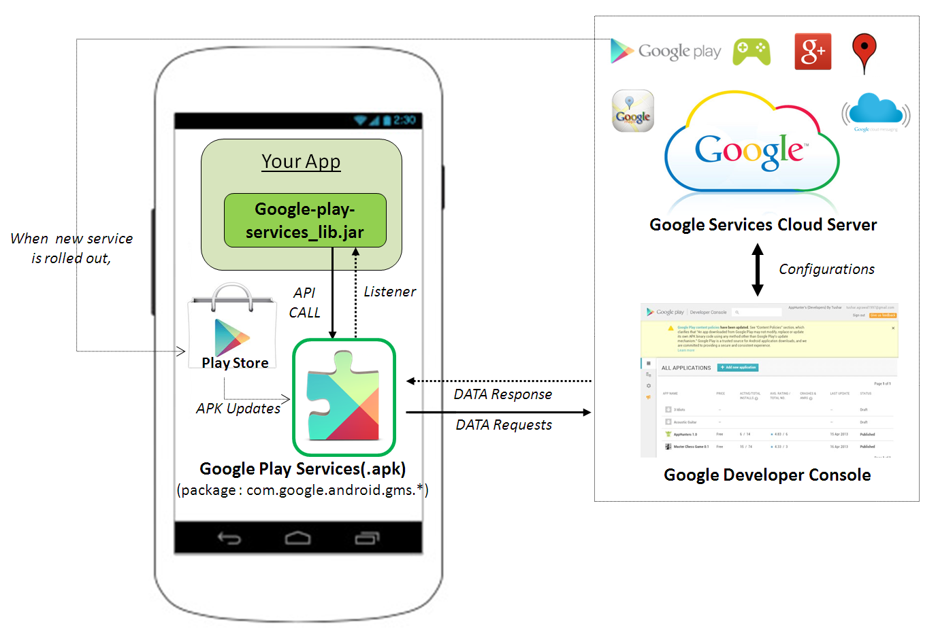

Slide 9
Android Developers ‘Toolbox’
Standard :
User Interface
IO widgets (buttons, textboxes, lists etc.)
Images
2D/3D drawing
ActionBar/ActionMode
ViewPager
NavDrawer
Database (Sqlite/Rooms)

Slide 10
Android Developers ‘Toolbox’
Advanced :
Google Maps
Google Sign-In
FireBase
Hardware APIs
GPS/Geo-location, calls, accelerometer, compass, bluetooth, camera
Fused Location Provider (latest addition)
Multiple processes
Managed by ART (as of Kit Kat 4.4+)
Background Services (e.g. AsyncTasks/Volley)
Inter-process communications (e.g. Intents)
No difference between third-party and native apps (2 lines of code to launch Camera on Device)

Slide 11
Android Applications (re : the installation stuff)
Android applications get distributed in a .apk file
APK == “Android Package”
It is simply an archive/zip file that has a particular file structure (similar to JAR files that take snapshots of the file system)
An APK contains
The Android Manifest file (an XML file with lots of metadata)
A Resource bundle containing sounds, graphics, etc.
The ART bytecodes that make up your application

Slide 12
Android Studio

Slide 13
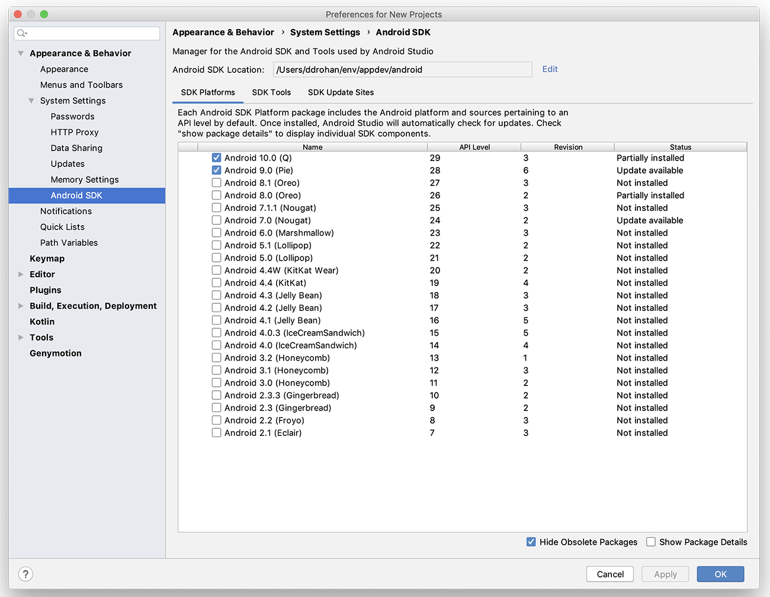
Android SDK Setup for the Labs *

Slide 14
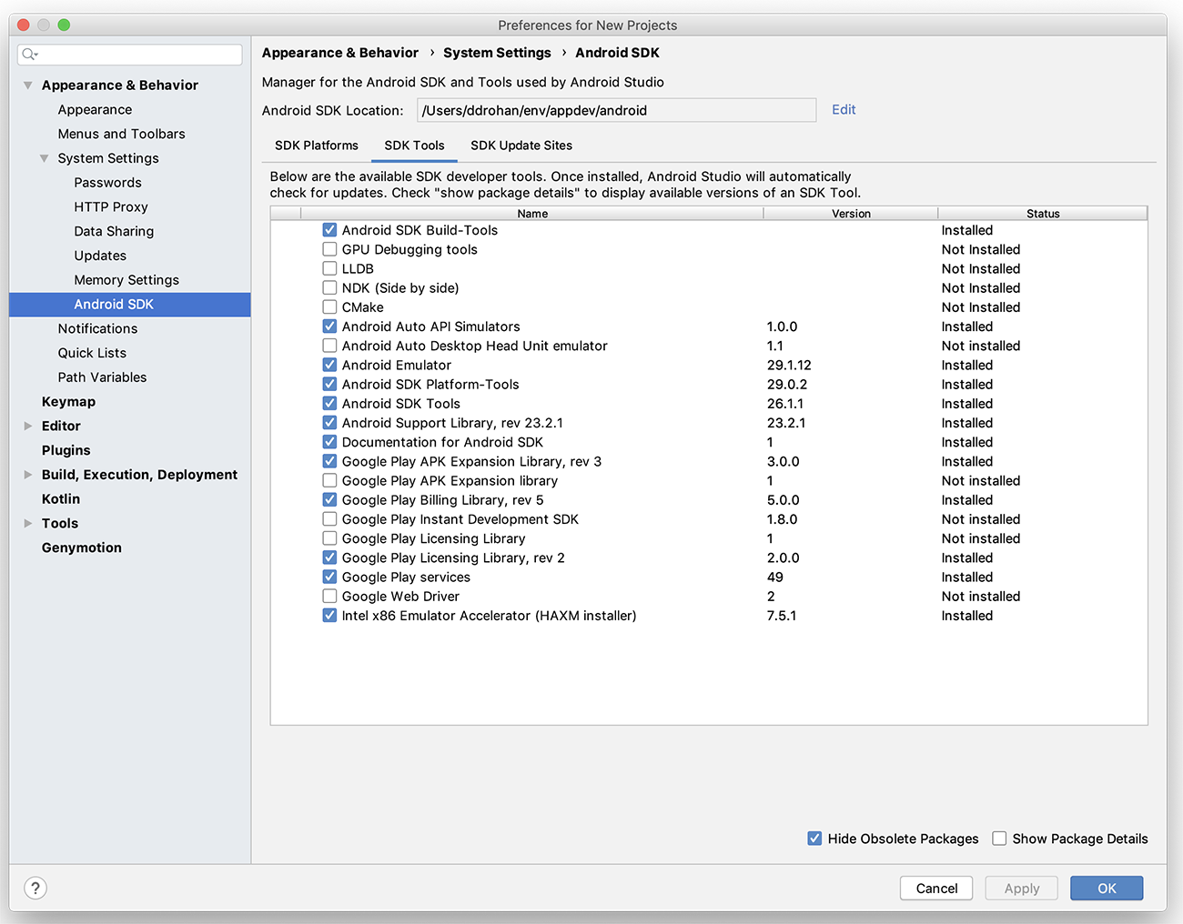
Android SDK Setup for the Labs *

Slide 15

Android Apps vs iPhone Apps
Introduction to Android

Slide 16
Installing Apps
For Generic (on the market) apps
iPhone has larger selection
Android catching up
For In-house-developed corporate apps
iPhone apps can only (mostly) be installed via the App Store
iPhone requires you to submit app to the Apple App Store and get approval, even for apps from your own company
Unless you setup a Provisioning profile or
you use something like TestFlight or
jailbreak your phone of course…..
Android apps can be installed through
Google Play
Amazon App Store
USB connection from PC
Email
Corporate Web site
Introduction to Android

Slide 17
Languages for Apps
iPhone
Objective-C
Similar to, but not exactly the same as, C++
Virtually no corporate presence for Objective-C, other than for mobile apps
However, Swift becoming ever more popular
Android
Java
The single most widely used language inside corporations
C/C++
Can call native apps (with some difficulty) via an approach similar to JNI for desktop Java
Kotlin gaining a lot of traction now with 1st Class Support from Google
Introduction to Android

Slide 18
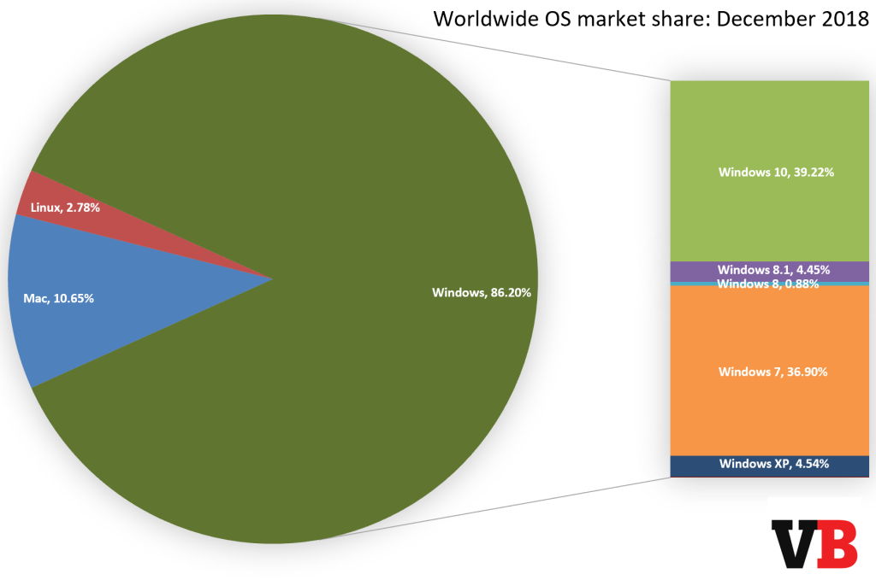
OS for Dev Apps
iPhone
Macs
Android
Anything with Java and Android Studio
Macs
PCs
Linux
Introduction to Android

Slide 19
Bottom Line: Android vs iPhone
Which to use personally
iPhone has bigger app store (only slightly!), and more loyal users
Android more open and growing more rapidly
Bottom line: no clear winner, personal preferences prevail, but iPhone has a technical edge
Which to use for in-house apps
iPhone apps very hard/restrictive to install, Android very simple
iPhone uses mainly Objective-C (Swift on the up), Android uses Java / Kotlin
Introduction to Android

